Slide 1
PinK: High-speed In-storage Key-value store with Bounded Tails
Im J. S. and Bae J. W., Chanwoo Chung and Arvind
2020 USENIX Annual Technical Conference, July, 2020
Presenter: 신호진
ghwls03s@gmail.com or hj03s@naver.com
2021. 01. 11

Slide 2
Introduction
Reference
Motivation
Hypothesis Testing
PinK: In-storage Key-value store
Evaluation
Conclusion

Slide 3
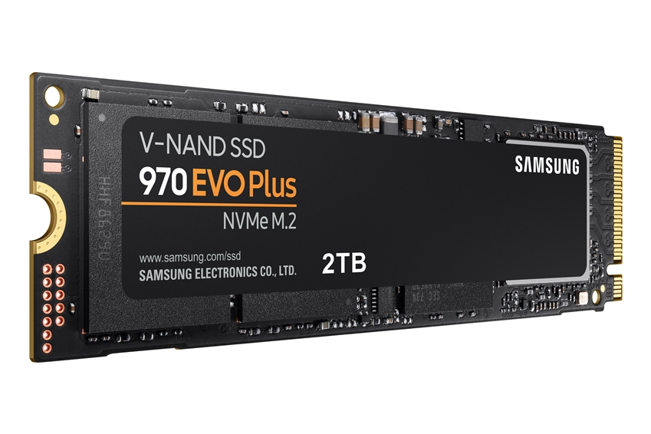
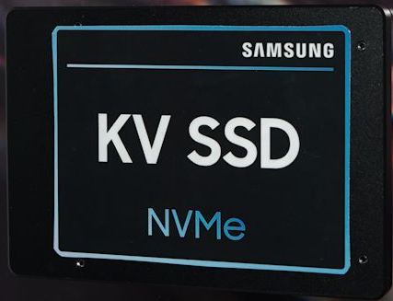

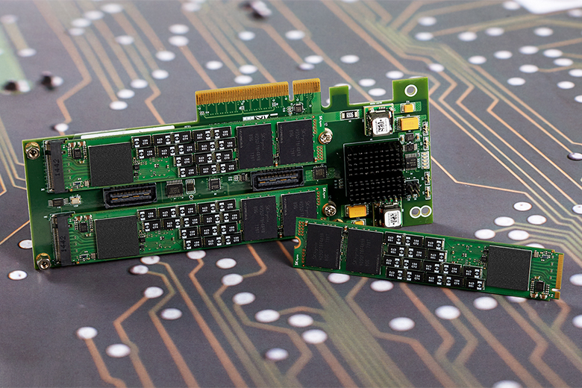
1. Introduction
The emergence of several types of SSD
SATA SSD
NVMe SSD
ZNS SSD
Key-value SSD

Slide 4
1. Introduction
The emergence of several types of SSD
SATA SSD
NVMe SSD
ZNS SSD
Key-value SSD
Block I/O Interface
Expose a linear array of 4KB logical blocks
Flash translation layer(FTL) in the SSD firmware
FTL maintains a mapping table indexed by logical block address
API = READ(), WRITE() …

Slide 5
1. Introduction
The emergence of several types of SSD
SATA SSD
NVMe SSD
ZNS SSD
Key-value SSD
Key-value I/O Interface
Container of key-value objects
Labeled by a unique key and contains an associated value
Key (~255B), value (~2MB)
API = GET(), SET() …

Slide 6
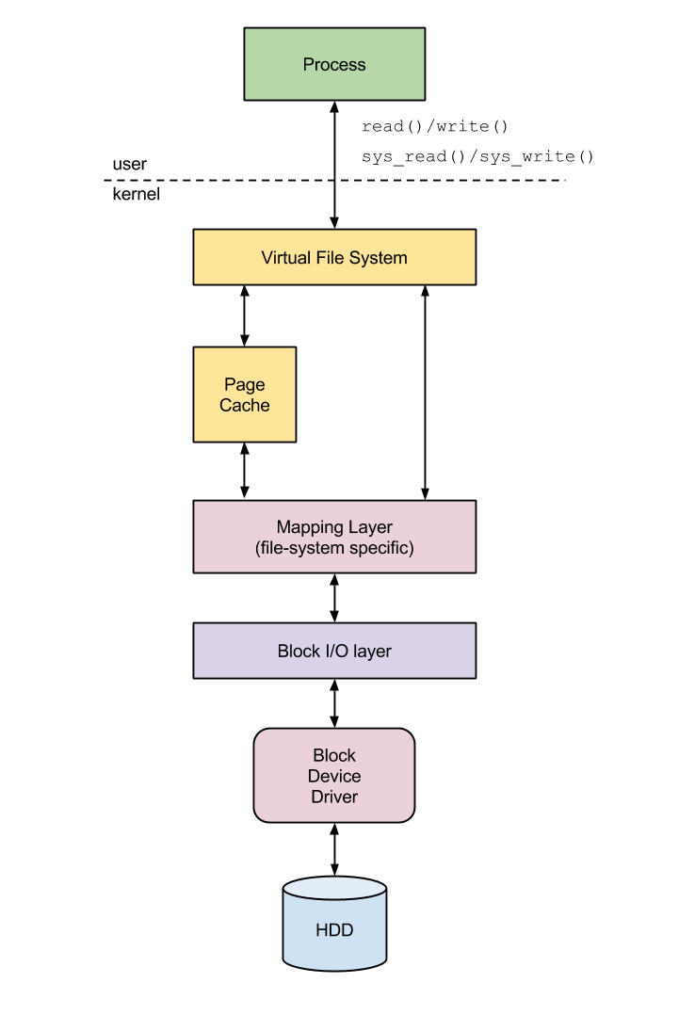
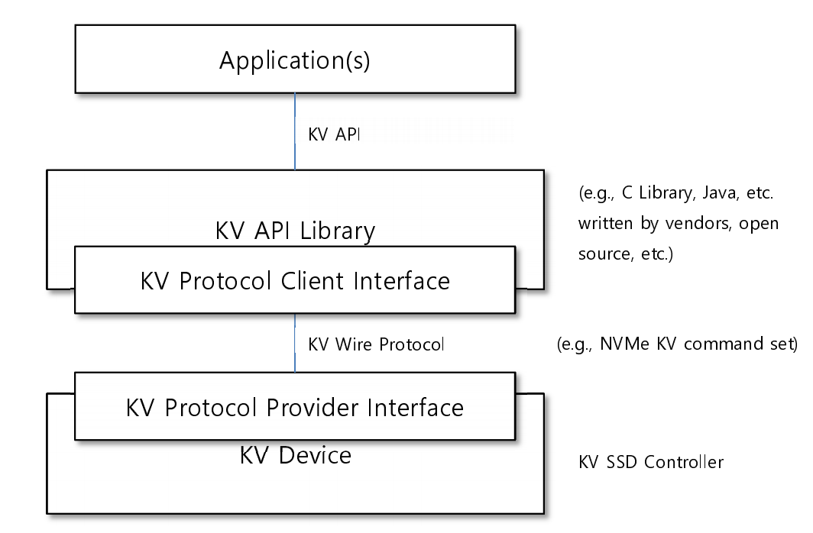
1. Introduction
Block I/O interface
Key-value I/O interface

Slide 7
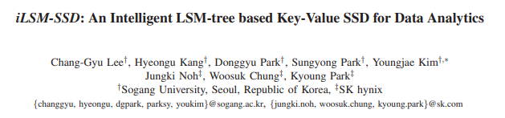
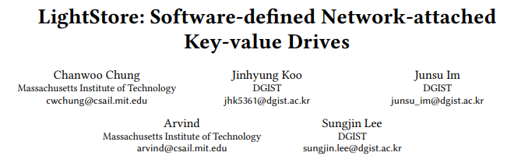
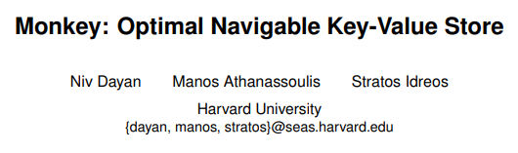
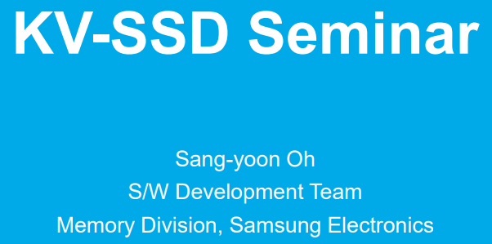
2. Reference

Slide 8
3. Motivation
Most of KV-SSDs are based on hash
Hash-based KV-SSD maintains a hash table in the controller DRAM. => (4TB SSD – 144GB DRAM)
But, not large enough to accommodate all the hash table entries.
Parts of the hash table must be stored in flash.
Data(KV pair)
(5GB)
PUT
Hash Table
(4GB)
DRAM(4GB)
NAND Flash
(1GB)
Flash

Slide 9
3. Motivation
Most of KV-SSDs are based on hash
Hash-based KV-SSD maintains a hash table in the controller DRAM. => (4TB SSD – 144GB DRAM)
But, not large enough to accommodate all the hash table entries.
Parts of the hash table must be stored in flash.
Data(KV pair)
(5GB)
KV Clients
PUT
Data GET request
GET
Hash Table
(4GB)
Hash Table
(4GB)
DRAM(4GB)
DRAM(4GB)
NAND Flash
(1GB)
Flash
NAND Flash
(1GB)
Flash

Slide 10
3. Motivation
Most of KV-SSDs are based on hash
Hash-based KV-SSD maintains a hash table in the controller DRAM. => (4TB SSD – 144GB DRAM)
But, not large enough to accommodate all the hash table entries.
Parts of the hash table must be stored in flash.
Data(KV pair)
(5GB)
KV Clients
PUT
Data GET request
No matching Data
Hash Table
(4GB)
Hash Table
(4GB)
DRAM(4GB)
DRAM(4GB)
NAND Flash
(1GB)
Flash
NAND Flash
(1GB)
Flash

Slide 11
3. Motivation
Most of KV-SSDs are based on hash
Hash-based KV-SSD maintains a hash table in the controller DRAM. => (4TB SSD – 144GB DRAM)
But, not large enough to accommodate all the hash table entries.
Parts of the hash table must be stored in flash.
Data(KV pair)
(5GB)
KV Clients
PUT
Data GET request
GET
Hash Table
(4GB)
Hash Table
(4GB)
DRAM(4GB)
DRAM(4GB)
NAND Flash
(1GB)
Flash
NAND Flash
(1GB)
Flash
Cause expensive flash access and complex hash table management
Or bucket collision and signature collision

Slide 12
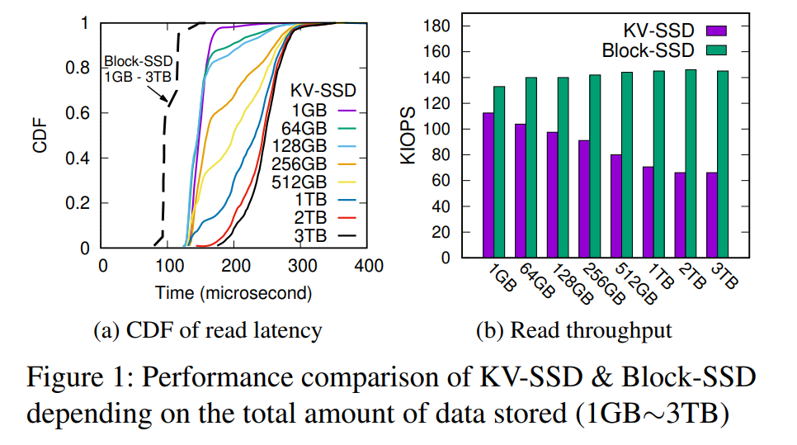
3. Motivation
Performance Comparison of KV-SSD & Block-SSD

Slide 13
3. Motivation
Performance Comparison of KV-SSD & Block-SSD
Then, isn’t KV-SSD
worse than Block-SSD?

Slide 14
3. Motivation
Performance Comparison of KV-SSD & Block-SSD
Then, isn’t KV-SSD
worse than Block-SSD?
Log-Structured
Merger tree

Slide 15
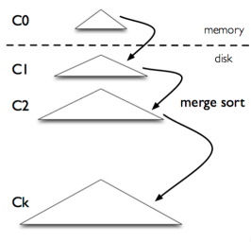
3. Motivation
LSM-Tree(Log-Structured Merge Tree)
Indices KV pairs in a multi-level sorted tree
Required much smaller DRAM for indexing KV pairs
But Conventional LSM-tree showed worse performance than hash
Probabilistic nature of Bloom Filter
High write amplification
Rebuilding bloom filter and sorting KV pairs for compaction
LSM-Tree abstract

Slide 16

3. Motivation
Propose an LSM-tree-based in-storage key-value store engine, called PinK
Level pinning – instead of keeping probabilistic Bloom filter
Reduce flash I/Os caused by compaction
Reduce GC I/Os by delaying index update operations
Hardware comparators - Accelerator
BTS
Stock
Samsung
Bitcoin
Twice
COVID-19

Slide 17
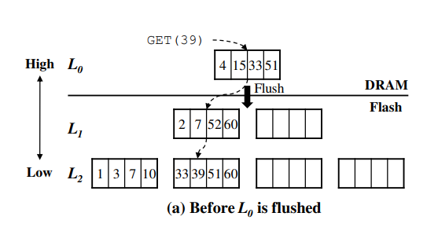
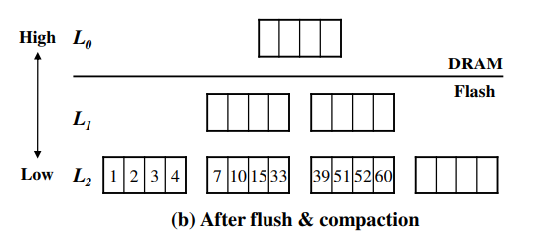

4. Hypothesis Testing
LSM-Tree Unique properties
For each level KV objects are unique and kept sorted by their key
The key range of one level may overlap the key range of other levels due to overlap

Slide 18
4. Hypothesis Testing
LSM-Tree Unique properties
For each level KV objects are unique and kept sorted by their key
The key range of one level may overlap the key range of other levels due to overlap

Slide 19
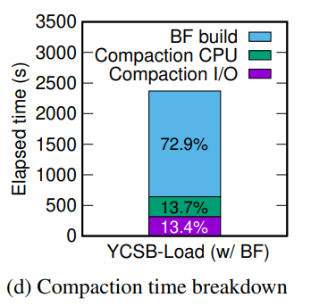
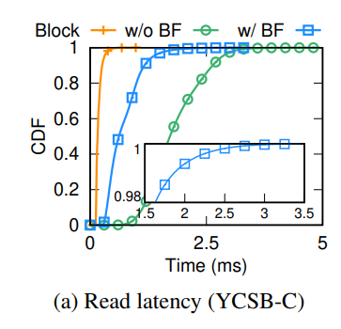
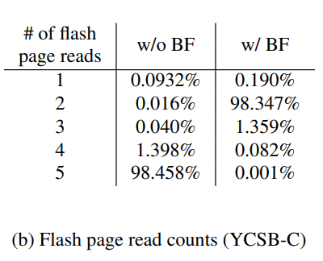
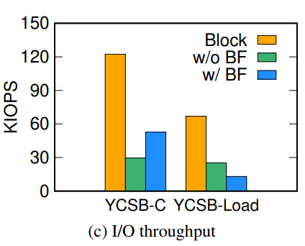
4. Hypothesis Testing
Performance Analysis
BF = Bloom Filter, YCSB-C = Read 100%
W = with, W/O = without

Slide 20

4. Hypothesis Testing
Observed Problem
Higher average-latency because of multi-level search, unpredictable tail latency because of Bloom filter
Bloom filter require lots of computational power to reconstruct
Level compaction also requires a lot of computation and I/O bandwidth
Compaction I/Os may trigger GC -> High write amplification

Slide 21
5. PinK: In-storage Key-value store
Design of PinK
Eliminate Bloom filter -> keep popular KV indices in DRAM
Mitigate the increased read latency by pinning top-K levels
Benefits for level pinning
Eliminates the flash I/Os required for compaction
Throughput can be further improved by using hardware accelerators
Alleviate the GC costs associated with compaction – delay GC

Slide 22
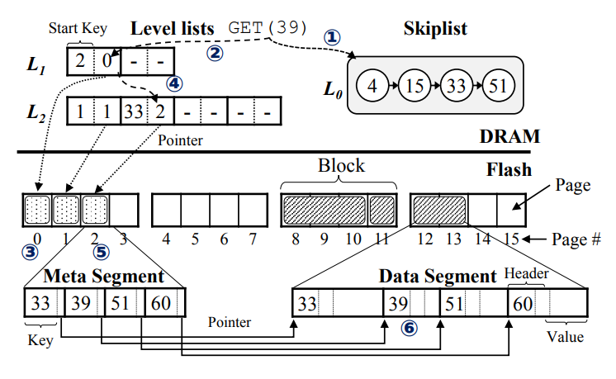
5. PinK: In-storage Key-value store
5.1 Overall Architecture
Skiplist, levellist, meta segment, data segment
Figure 4 : An overall architecture of PinK with its ket data structure in DRAM and flash

Slide 23
5. PinK: In-storage Key-value store
5.1 Overall Architecture
Skiplist
Corresponds to L0
L0 size – 8MB ~ 64MB
Four fields <key size; key; value size; value>
Levellist
Meta segment
Data segment

Slide 24
5. PinK: In-storage Key-value store
5.1 Overall Architecture
Skiplist
Corresponds to L0
L0 size – 8MB ~ 64MB
Four fields <key size; key; value size; value>
Levellist
In-memory data structure, keep track of meta segment, except L0
Each levellist is organized as an array of pairs of fixed-size pointer (4B each, 8B total)
(physical location of a meta segment, start key of a meta segment)
Meta segment
Data segment

Slide 25
5. PinK: In-storage Key-value store
5.1 Overall Architecture
Skiplist
Corresponds to L0
L0 size – 8MB ~ 64MB
Four fields <key size; key; value size; value>
Levellist
In-memory data structure, keep track of meta segment, except L0
Each levellist is organized as an array of pairs of fixed-size pointer (4B each, 8B total)
(physical location of a meta segment, start key of a meta segment)
Meta segment
Contains keys and pointers to its associated values in data segment
Fixed to flash page size (8KB ~ 16KB)
<key, pointer> = <16B~128B, 4B integer> + header
Data segment

Slide 26
5. PinK: In-storage Key-value store
5.1 Overall Architecture
Skiplist
Corresponds to L0
L0 size – 8MB ~ 64MB
Four fields <key size; key; value size; value>
Levellist
In-memory data structure, keep track of meta segment, except L0
Each levellist is organized as an array of pairs of fixed-size pointer (4B each, 8B total)
(physical location of a meta segment, start key of a meta segment)
Meta segment
Contains keys and pointers to its associated values in data segment
Fixed to flash page size (8KB ~ 16KB)
<key, pointer> = <16B~128B, 4B integer> + header
Data segment
L0 and levellist are protected by capacitor
Dose not need WAL(write-ahead-log) – provide atomicity and durability of data

Slide 27
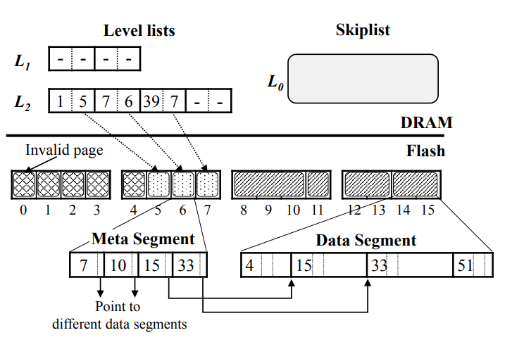
5. PinK: In-storage Key-value store
5.2 Improving I/O Speed with Level pinning
Eliminating Read Tails
Get rid of Bloom filter, adopts level pinning
Keeps meta segments for top-k levels in DRAM
Worst case flash lookups is reduce to O(h-k-1)
Level-pinning Memory Requirement
The level pinning require large amounts of DRAM? No
Level size increases exponentially by a factor of T
Reducing Compaction I/Os
Eliminates flash I/Os involved in compaction
Meta segment can be updated in DRAM directly
Before compaction
After compaction

Slide 28
5. PinK: In-storage Key-value store
5.2 Improving I/O Speed with Level pinning
Eliminating Read Tails
Get rid of Bloom filter, adopts level pinning
Keeps meta segments for top-k levels in DRAM
Worst case flash lookups is reduce to O(h-k-1)
Level-pinning Memory Requirement
The level pinning require large amounts of DRAM? No
Level size increases exponentially by a factor of T
Reducing Compaction I/Os
Eliminates flash I/Os involved in compaction
Meta segment can be updated in DRAM directly
Before compaction
After compaction

Slide 29
5. PinK: In-storage Key-value store
5.2 Improving I/O Speed with Level pinning
Eliminating Read Tails
Get rid of Bloom filter, adopts level pinning
Keeps meta segments for top-k levels in DRAM
Worst case flash lookups is reduce to O(h-k-1)
Level-pinning Memory Requirement
The level pinning require large amounts of DRAM? No
Level size increases exponentially by a factor of T
Reducing Compaction I/Os
Eliminates flash I/Os involved in compaction
Meta segment can be updated in DRAM directly
Before compaction
After compaction

Slide 30
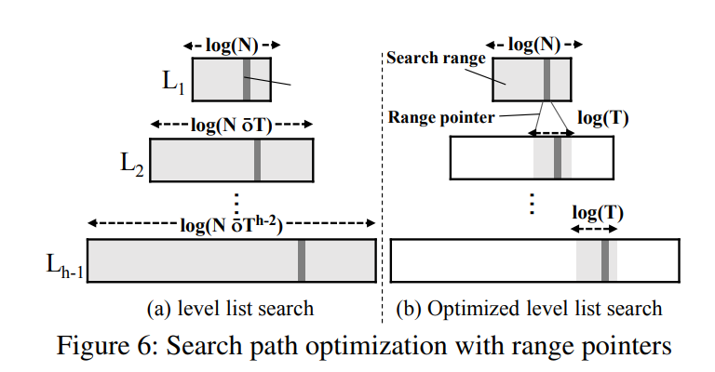
5. PinK: In-storage Key-value store
5.3 Optimizing Search Path
Problem
Level size increase by a factor of T -> O(h^2*log(T))
Solution
Using a prefix a key (4B of a start key, while binary search)
By borrowing fractional cascading technique
Only L1 maintain range pointer

Slide 31
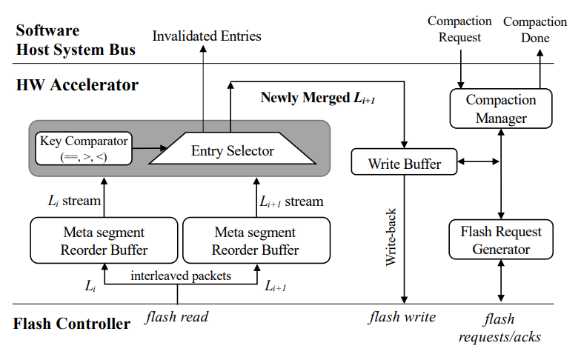
5. PinK: In-storage Key-value store
5.4 Speeding up Compaction

Slide 32
5. PinK: In-storage Key-value store
5.4 Speeding up Compaction
ⓐ

Slide 33
5. PinK: In-storage Key-value store
5.4 Speeding up Compaction
ⓑ

Slide 34
5. PinK: In-storage Key-value store
5.4 Speeding up Compaction
ⓒ

Slide 35
5. PinK: In-storage Key-value store
5.4 Speeding up Compaction
ⓓ

Slide 36
5. PinK: In-storage Key-value store
5.4 Speeding up Compaction
ⓔ

Slide 37
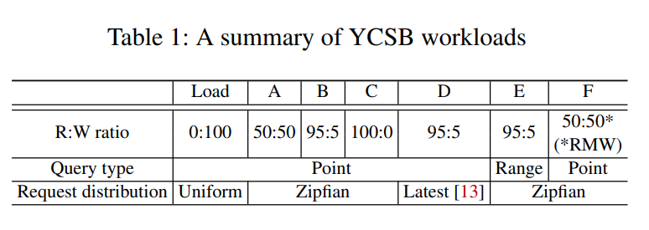
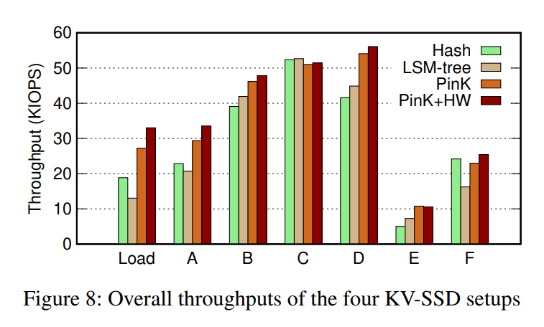
6. Evaluation

Slide 38
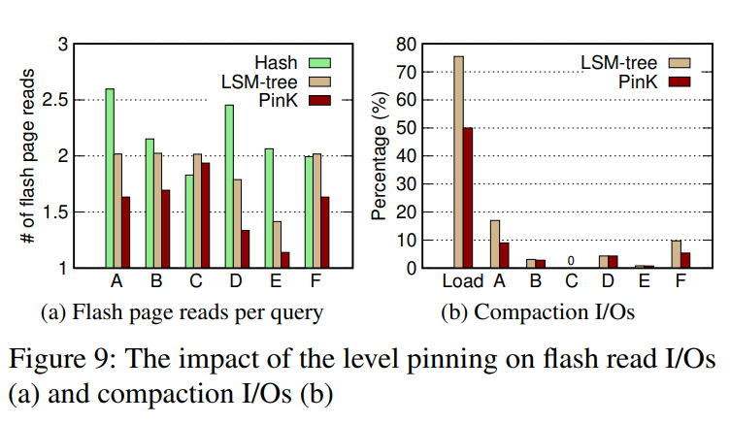
6. Evaluation

Slide 39
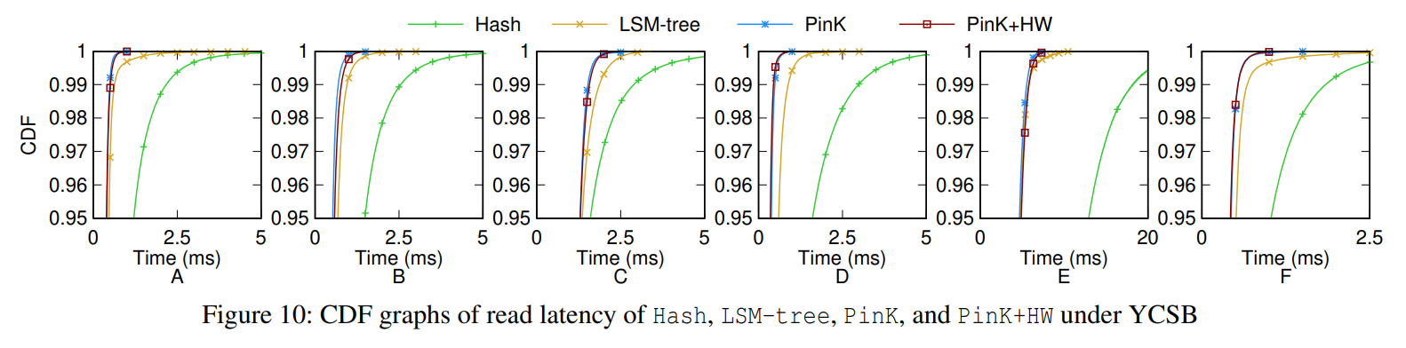
6. Evaluation

Slide 40
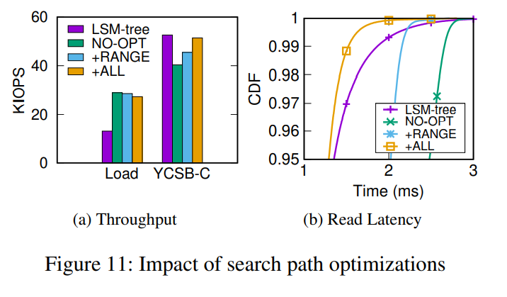
6. Evaluation

Slide 41
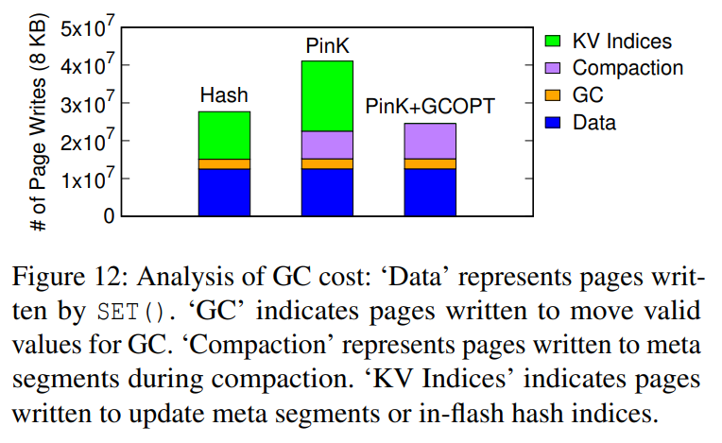
6. Evaluation

Slide 42
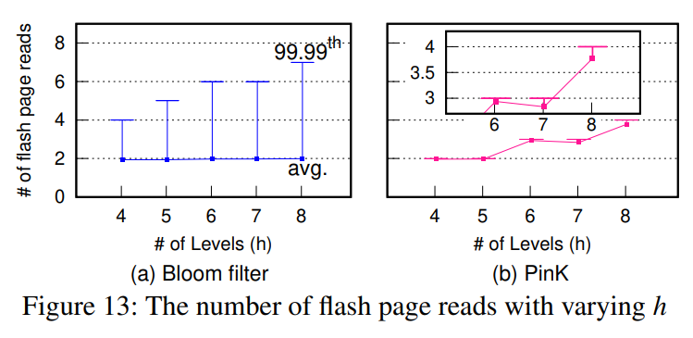
6. Evaluation

Slide 43

7. Conclusion
Presented a novel LSM-tree-based KV-SSD design, called PinK
By pinning KV indices of top levels of the LSM tree to DRAM, guarantee the worst-case read latency, while improving average read latency
Not only eliminated sorting overheads, but reduced I/O operations related to compaction greatly

Slide 44
PinK: High-speed In-storage Key-value store with Bounded Tails
Im J. S. and Bae J. W., Chanwoo Chung and Arvind
2020 USENIX Annual Technical Conference, July, 2020
Thank You!
Presenter: 신호진
ghwls03s@gmail.com or hj03s@naver.com
2021. 01. 11

